Slide 1
Tutorial Outline
Time | Topic
9:00 am – 9:30 am | Introduction
9:30 am – 10:10 am | Standalone Accelerator Simulation: Aladdin
10:10 am – 10:30 am | Standalone Accelerator Generation: High-Level Synthesis
10:30 am – 11:00 am | HLS-Based Accelerator-Rich Architecture Simulation: PARADE
11:00 am – 11:30 am | Break
11:30 am – 12:00 pm | Pre-RTL SoC Simulation: gem5-Aladdin
12:00 pm – 12:30 pm | FPGA Prototyping: ARACompiler
12:30 pm – 2:00 pm | Lunch
2:00 pm – 3:00 pm | Panel on Accelerator Research
3:00 pm – 3:30 pm | Accelerator Benchmarks and Workload Characterization
3:30 pm – 4:00 pm | Break
4:00 pm – 5:00 pm | Hands-on Exercise

Slide 2


PARADE: A Cycle-Accurate Full-System Simulation Platform for Accelerator-Rich Architectural Design and Exploration
Zhenman Fang, Michael Gill
Jason Cong, Glenn Reinman
Center for Domain-Specific Computing
Center for Future Architectures Research
Computer Science Department, UCLA
[ICCAD 15]

Slide 3
The Power Wall and Customized Computing
Parallelization
Customization
Adapt the architecture to
application domain
Source: Shekhar Borkar, Intel

Slide 4
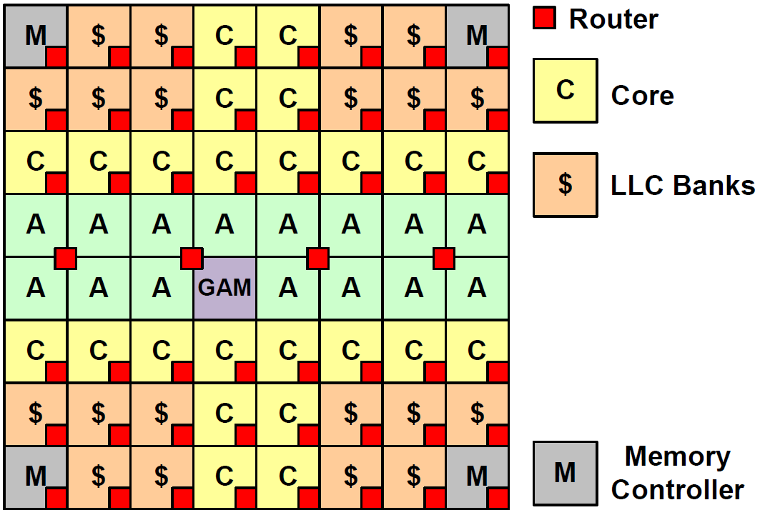
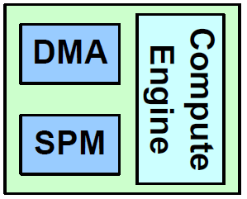
The Trend of Accelerator-Rich Architecture (ARA)
From ARC [DAC 12]
& CHARM [DAC 14]
Global Accelerator Manager (GAM) with shared TLB

Slide 5
Our Motivation and Goal
A stack of research tools for accelerator-rich architecture
  Standalone accelerator simulation: Aladdin
  Standalone accelerator generation: HLS
  System-level HLS-based ARA simulation: PARADE
  System-level pre-RTL SoC simulation: gem5 + Aladdin
  ARA FPGA prototyping: ARACompiler
Spare the community the difficulties we have encountered
Accelerate the adoption of accelerator-rich architecture (ARA)
early-stage
late-stage

Slide 6
PARADE: Platform for Accelerator-Rich
Architectural Design & Exploration [ICCAD 15]
extended m5 (McPAT)
for X86 CPU, with OS
auto-generated accelerators based on HLS (AutoPilot)
added SPM, DMA,
GAM & TLB model
extended Garnet
(DSENT) for NoC
extended Ruby (CACTI) for
coherent cache hierarchy
gem5 memory
model [ISPASS 14]

Slide 7
HLS-based Automatic Accelerator Generation
Accelerator
Source Code
C function
to accelerate
High-Level Synthesis
Application Dataflow
RTL
model
Simulation Module Generator
RTL Synthesis
Accelerators chaining info
Timing info e.g., II, clk
Simulation
module info
Program
Generator
Simulation Module
Generated Program
Handles accelerator communication, task buffer, interrupts, …
Input
Tool
Output

Slide 8
Visualization Support
L1D_0
router_0
core_0
acc_0
router_1
L1D_1
L2_0
L2_1
L1D_2
router_2
GAM
acc_1
router_3
L1D_3
L2_2
mc_0
L2_3
According to the component’s utilization, assign a different color.
The dark red indicates a potential bottleneck!

Slide 9
Tutorial Agenda
Building the PARADE simulator
Creating a benchmark
Running a benchmark on PARADE
Performance and energy analysis using PARADE
  Performance breakdown
  Energy breakdown
Simulation speed of PARADE
Summary of PARADE features

Slide 10
Building PARADE
Use an existing accelerator module: VectorAddSample
  #include "VectorAddSample.hh” in LCAccOperatingModeInclude.hh
    VectorAddSample.hh contains accelerator modeling details
  REGISTER_OPMODE(OperatingMode_VectorAddSample) in LCAccOperatingModeListing.hh
  g_LCAccInterface->AddOperatingMode(g_LCAccDeviceHandle[0], "VectorAddSample"); in startup() mem/ruby/system/System.cc
The same compiling command as gem5 (32nm @2GHz)
  scons PROTOCOL=MESI_Two_Level_Trace build/X86/gem5.opt

Slide 11
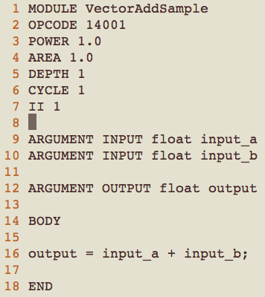
Adding an Accelerator Simulation Module
User high-level description: VectorAddSample.type
Specify an unique accelerator
module name and opcode
1390 uw
52806 um²
10
2 (1GHz)
1
Replace timing by our HLS/RTL tool
./run.autopilot.sh VectorAddSample.type
Specify accelerator
inputs and outputs
Specify accelerator computation body: one iteration in the loop

Slide 12
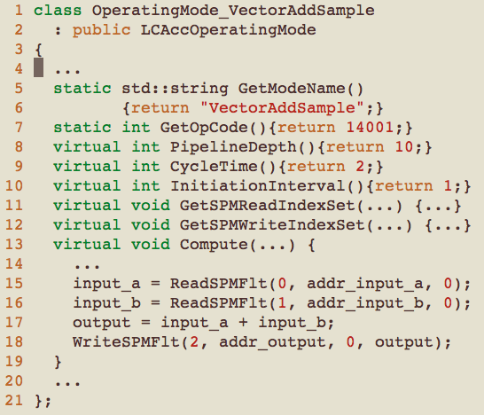
Auto-Generated Accelerator Simulation Module
Auto-generated accelerator module: VectorAddSample.hh
each accelerator inherits the LCAccOperationMode class
accelerator module
name and opcode
accelerator timing
info from HLS/RTL
auto-generated SPM address mapping
model SPM/DMA timing, and computation latency
mono AccGen.exe -path:src/modules/LCAcc VectorAddSample.type

Slide 13
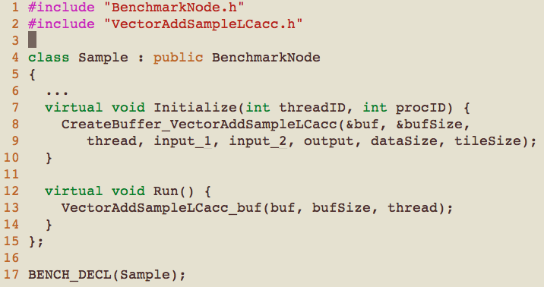
Creating a Benchmark
To use existing accelerators, just call accelerator API
base BenchmarkNode class
include accelerator API
inherit BenchmarkNode
call the CreateBuffer API to init the accelerator, write the program description to memory buffer
call the run_buf API to read the accelerator, run it, handle the communication with CPU and GAM
Create a BenchmarkNode, call Initialize() and Run()

Slide 14
Within the Accelerator Library (for Benchmarks)
3
CPU
1
New ISA
lcacc-req type
lcacc-rsrv id, time
lcacc-cmd id, cmd, addr
lcacc-free id
GAM
2
4
5
4
7
5
Mem
Task description
6
Acc
4
Request available accelerators (lcacc-req)
Response available ones & waiting time
Request reservation (lcacc-rsv) and wait
Reserve accelerator, send it the core ID
The core shares a task description and
start the accelerator (lcacc-cmd)
Read task & start work
Work done, notify the core
Free accelerators (lcacc-free)
Users don’t have to worry about these,
we provide a dataflow language and tool to automatically generate the library

Slide 15
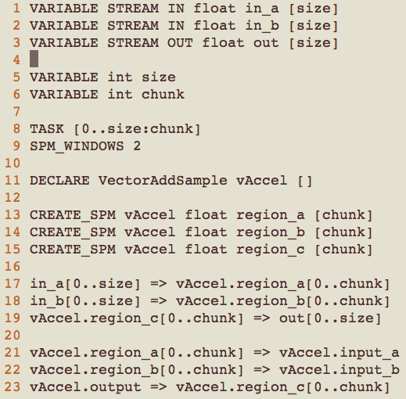
Creating an Accelerator Library (for Benchmarks)
To create an accelerator library, specify accelerator dataflow
(mono ApGen.exe VectorAddSample.txt VectorAddSampleLCacc.h)
input and output
whole data size and tile size
task based on tile size (chunk)
use double SPM buffer
declare the accelerator
create SPM for input/output
data transfer based on tile:
input LLC/DRAM -> SPM &
output SPM -> LLC/DRAM
trigger accelerator within tile:
input SPM -> Register &
output Register -> SPM

Slide 16
Running a Benchmark on PARADE
Similar gem5 command to run benchmarks
  ./gem5.opt --outdir=./TDLCA_BlackScholes/ configs/example/fs.py full-system config
  --checkpoint-dir=./ckpt-1core/ --restore-with-cpu=timing -r 1 -n 1 restore checkpoint
  -s 16565183 -W 16565183 timing warmup initialization, then switch to OoO
  --ruby --l2_size=64kB --num-l2caches=32 32-banked 2MB LLC with Ruby
  --mem-size=2GB --num-dirs=4 2GB memory with 4 DDR3 controllers
  --garnet=fixed --topology=Mesh --mesh-rows=4 4*8 mesh with Garnet
  --lcacc --accelerators=1 1 copy of accelerator
  --script=./configs/boot/BlackScholes.td.rcS BlackScholes boot script
  >& TDLCA_BlackScholes/result.txt redirect output to result.txt
Output statistics of PARADE
  Stats.txt, result.txt, and visual.txt (visualization trace)

Slide 17
Execution Cycles for BlackScholes
94X
64X
155X

Slide 18
Execution Cycles for BlackScholes (cont.)
Total cycles: check stats.txt
  system.switch_cpus_1.numCycles 3158763
CPU/SW computation time (assume perfect cache)
  Change configuration to use 20MB L2 cache with 1 cycle latency
ARA computation/communication time
  Result.txt contains start, and end time for each task computation and data transfer
  Postprocessing “ResultParser result.txt”, it will generate

Slide 19
Issuing IPC Breakdown for BlackScholes
No issuing instruction
For the accelerator version, it’s customized
to a fully-utilized 234-stage deep pipeline

Slide 20
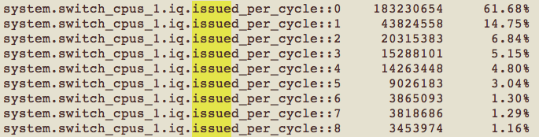
Issuing IPC Breakdown for BlackScholes (cont.)
Check stats.txt
ARA version based on HLS
  ./run.autopilot.sh BlackScholes.type

Slide 21
# of Cache/Memory Access for BlackScholes
42X L1D reduction by
removing register spilling
removed
instructions
no notable reduction

Slide 22
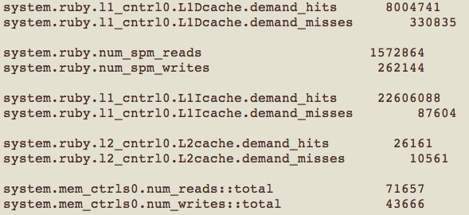
# of Cache/Memory Access for BlackScholes (cont.)
Check stats.txt

Slide 23
Cache/Memory Bandwidth for BlackScholes
Bandwidth = Access * 64B * 10⁻⁶/ (Cycles/2GHz) (MB/s)
improved LLC/DRAM effective bandwidth

Slide 24
Energy Breakdown for Deblur

Slide 25
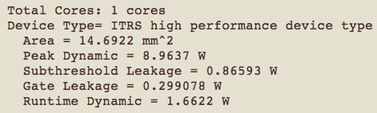
Energy Breakdown for Deblur (cont.)
Energy = power * time, we measure power directly
Accelerator power: given by run.autopilot.sh
DRAM power (gem5 integrated Micron model, ISPASS 14)
  system.mem_ctrls0.averagePower::0 753.996167 in stats.txt
Core power (McPAT)
  generate.mcpat.xml.sh convert gem5 statistics to mcpat xml
  generate.mcpat.energy.sh generate power numbers

Slide 26
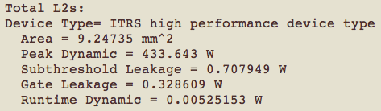
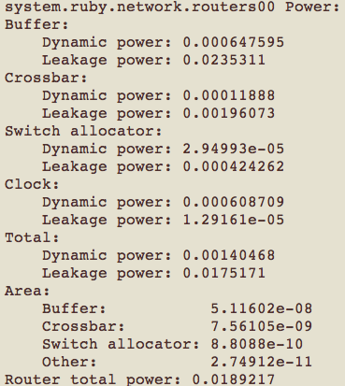

Energy Breakdown for Deblur (cont.)
LLC power (CACTI, integrated with McPAT)
NoC power (DSENT)
  run generate.dsent.sh

Slide 27
Simulation Speed of PARADE
KIPS: Kilo Instructions
simulated Per Second
15X

Slide 28
PARADE: Platform for ARA Design & Exploration
Based on widely-used gem5 and support full-system X86
Global Accelerator Management (GAM)
Coherent cache/SPM with shared memory (Ruby)
Customizable Network-on-Chip simulation (Garnet)
Power/area simulation
  McPAT for CPUs; high-level synthesis (AutoPilot) for accelerators
  CACTI for caches; DSENT for NoC, Micron model for DRAM
Visualization to assist design space exploration

Slide 29


Thank You!
For more information, please contact Zhenman Fang, zhenman@cs.ucla.edu
Tutorial website: http://accelerator.eecs.harvard.edu/isca15tutorial/

